Slide 1

KKR&KSR INSTITUTE OF TECHNOLOGY AND SCIENCES
(Approved by AICTE, Permanently Affiliated to JNTU Kakinada, Accredited by NBA & Accredited by NAAC 'A'Grade,
Vinjanampadu (V) Vatticherukuru (M), Guntur (DT) – 522017)
DEPARTMENT OF INFORMATION TECHNOLOGY
REVIEW 0
PROJECT TEAM:
20JR1A1242
20JR1A1259
20JR1A1261
20JR1A1266
PROJECT GUIDE:
B.NAGAESWARI
ASSISTANT PROFESSOR

Slide 2
IMAGE GENERATION
WITH
STYLE TRANSFER

Slide 3
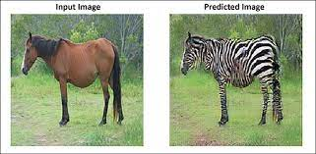
IMAGE GENERATION
WITH
STYLE TRANSFER

Slide 4
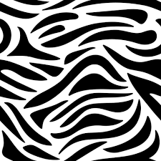
IMAGE GENERATION
WITH
STYLE TRANSFER

Slide 5
Brushing Pixels:
Crafting Aestetic LandScapes Through Style transfer
Transforming Realities:
A Dive into image
Style Trasfer
Blending Art and Pixels for Stunning Visuals

Slide 6
Brushing Pixels:
Crafting Aestetic LandScapes Through Style transfer
Transforming Realities:
A Dive into image
Style Trasfer
Blending Art and Pixels for Stunning Visuals

Slide 7
Brushing Pixels:
Crafting Aestetic LandScapes Through Style transfer
Transforming Realities:
A Dive into image
Style Trasfer
Blending Art and Pixels for Stunning Visuals

Slide 8
ABSTRACT
In the world of digital art, Image Style Transfer is a captivating technique that allows artists and enthusiasts to infuse their pictures with the charm of famous artistic styles.
This process involves seamlessly applying the visual elements of one image onto another, resulting in a harmonious blend of content and style.
This abstract explores the natural and intuitive aspects of Image Style Transfer, shedding light on how enthusiasts can effortlessly transform their photographs into visually striking compositions
KEY WORDS:
Neural Style Transfer (NST),Texture Synthesis, Optimization Methods, Instance Normalization

Slide 9
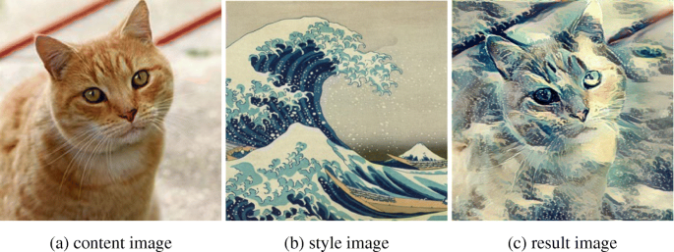
INTRODUCTION
Transform regular photos into artistic masterpieces.
Blend the look of one picture with the style of another.
+
=

Slide 10
Literature Review
Neural Style Transfer (NST):
Research indicates that NST, using pre-trained convolutional neural networks (CNNs), has gained popularity for artistic image synthesis (Gatys et al., 2015).
Studies highlight its effectiveness in separating content and style features, providing a robust framework for image stylization (Johnson et al., 2016).
Texture Synthesis Techniques:
Texture synthesis approaches have been explored for their ability to replicate visual patterns from style images onto content images (Portilla et al., 2000).
Researchers emphasize the importance of analyzing local structures to achieve realistic and visually appealing stylized outputs (Efros & Freeman, 2001).
Optimization Methods in Style Transfer:
Optimization algorithms, such as gradient descent, play a crucial role in adjusting pixel values to minimize differences between content and style images (Li et al., 2016).
The literature underscores the delicate balance required to preserve content while adopting the desired artistic style (Gatys et al., 2016).

Slide 11
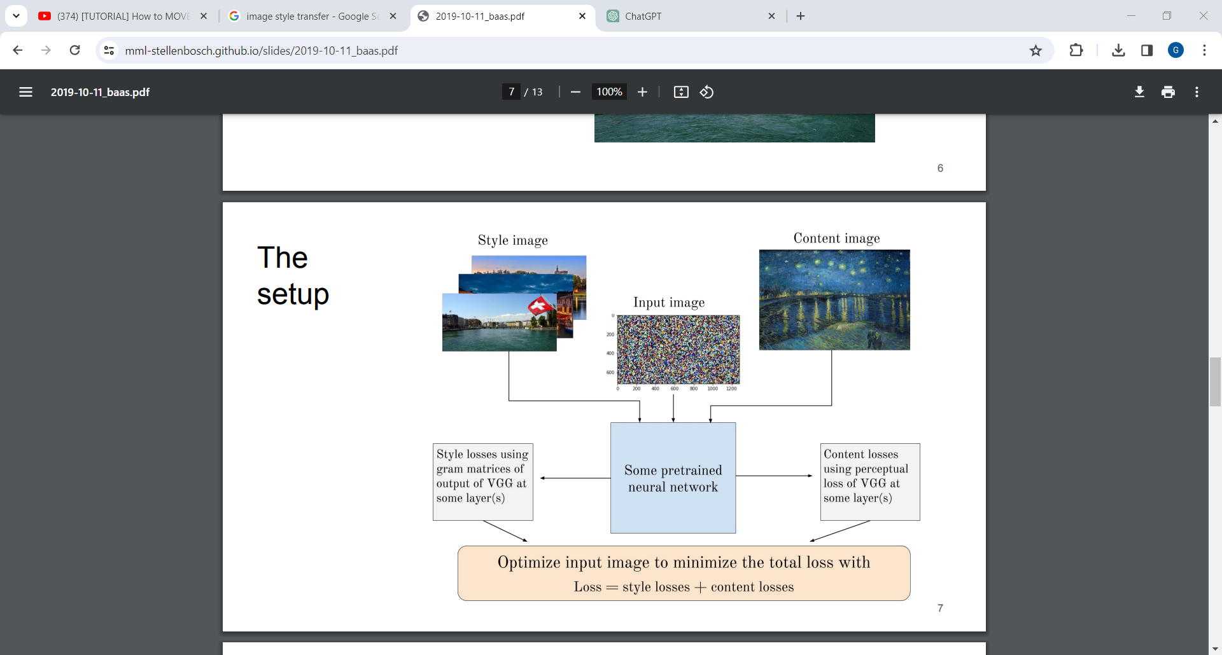
PROBLEM STATEMENT

Slide 12
PROBLEM STATEMENT
PROBLEM OCCURS

Slide 13
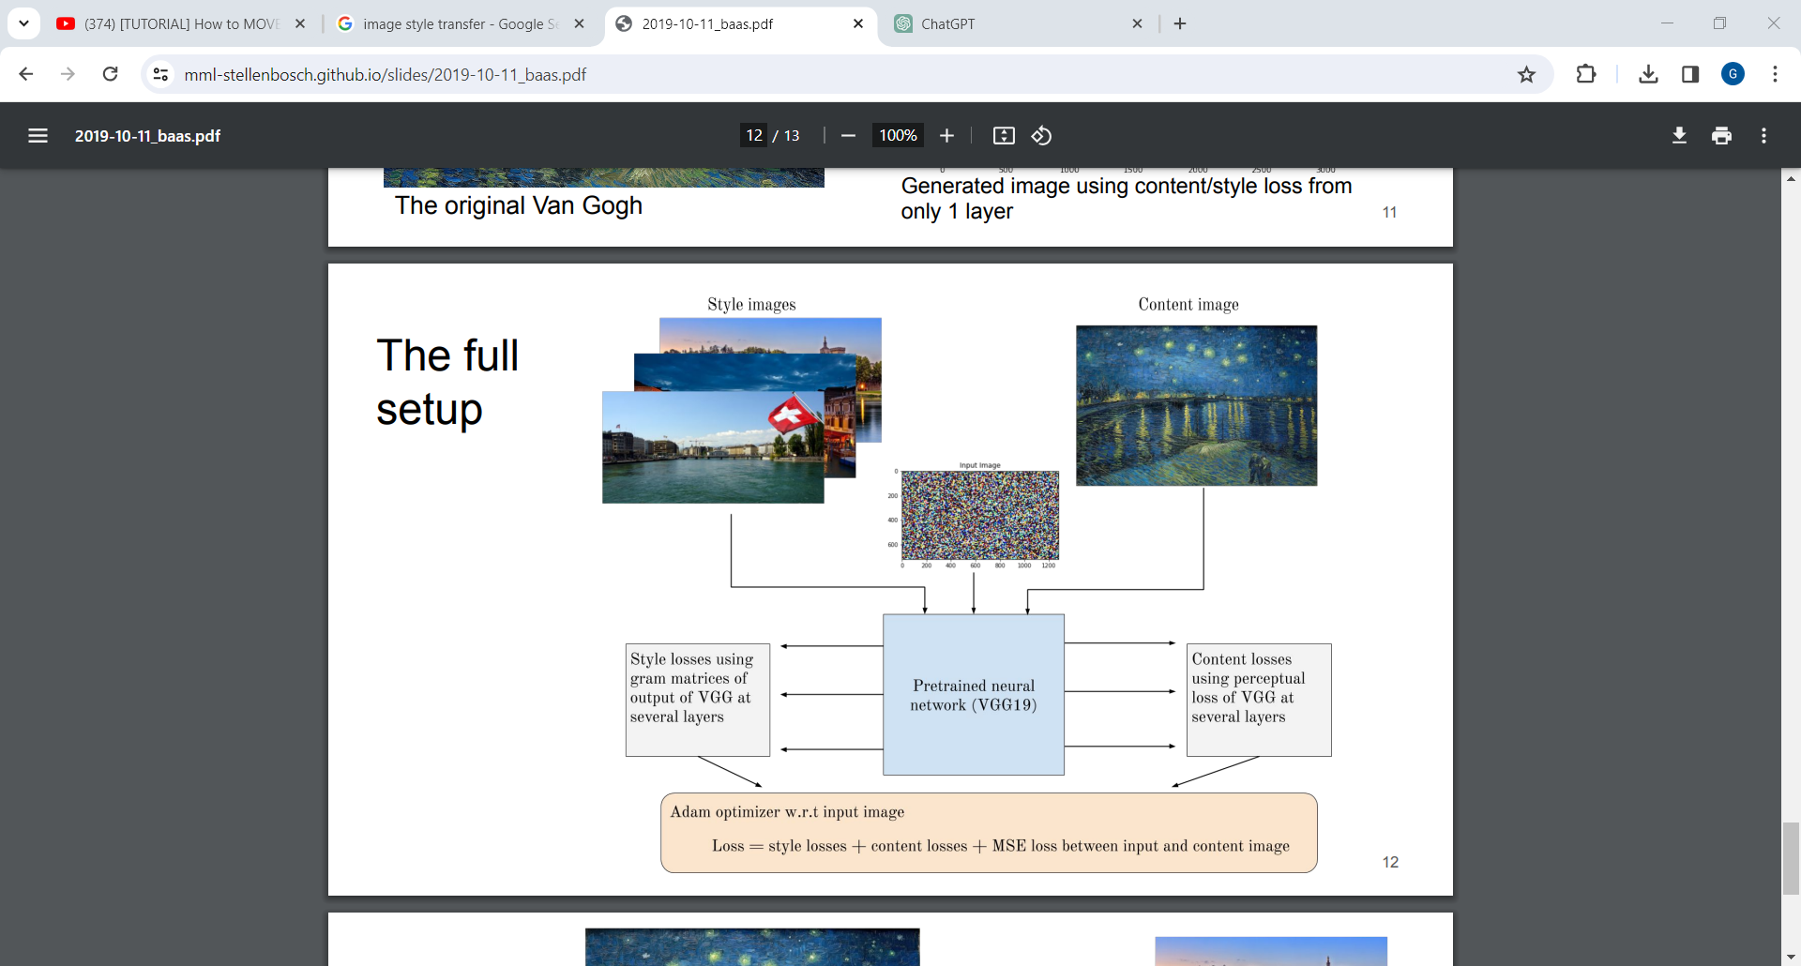
PROPOSED SYSTEM

Slide 14
THANK
YOU

